Slide 1


Gopga Aqsha Muhadi
11/11/2023

Slide 2

Outline
Executive Summary
Introduction
Methodology
Results
Conclusion
Appendix

Slide 3
Executive Summary
We collected data from public SpaceX API and SpaceX Wikipedia page. Created labels column ‘class’ which classifies successful landings. Explored data using SQL, visualization, folium maps, and dashboards. Gathered relevant columns to be used as features. Changed all categorical variables to binary using one hot encoding. Standardized data and used GridSearchCV to find best parameters for machine learning models. Visualize accuracy score of all models.
Four machine learning models were produced: Logistic Regression, Support Vector Machine, Decision Tree Classifier, and K Nearest Neighbors. All produced similar results with accuracy rate of about 83.33% except Decision tree with a higher accuracy of 95%. All models over predicted successful landings. More data is needed for better model determination and accuracy.

Slide 4
Introduction
BACKGROUND:
We’re going into a commercial space age
SpaceX has the best pricing (largely due to being able to recover rocket parts)
SpaceY is trying to compete with SpaceX
PROBLEM:
SpaceY gave us a task to train an ML model to predict successful stage 1 recovery

Slide 5

Section 1

Slide 6
Methodology
Executive Summary
Data collection methodology:
Combined data from SpaceX public API and SpaceX Wikipedia page
Perform data wrangling
Classifying true landings as successful and unsuccessful otherwise
Perform exploratory data analysis (EDA) using visualization and SQL
Perform interactive visual analytics using Folium and Plotly Dash
Perform predictive analysis using classification models
Tuned model using GridSearchCV

Slide 7
Data Collection
Data collection process involved a combination of API requests from Space X public API and web scraping data from a table in Space X’s Wikipedia entry.
The next slide will show the flowchart of data collection from API and the one after will show the flowchart of data collection from webscraping.
Space X API Data Columns:
FlightNumber, Date, BoosterVersion, PayloadMass, Orbit, LaunchSite, Outcome, Flights, GridFins,
Reused, Legs, LandingPad, Block, ReusedCount, Serial, Longitude, Latitude
Flight No.,
Wikipedia Webscrape Data Columns:
Launch site, Payload, PayloadMass, Orbit, Customer, Launch outcome, Version Booster, Booster landing, Date, Time

Slide 8
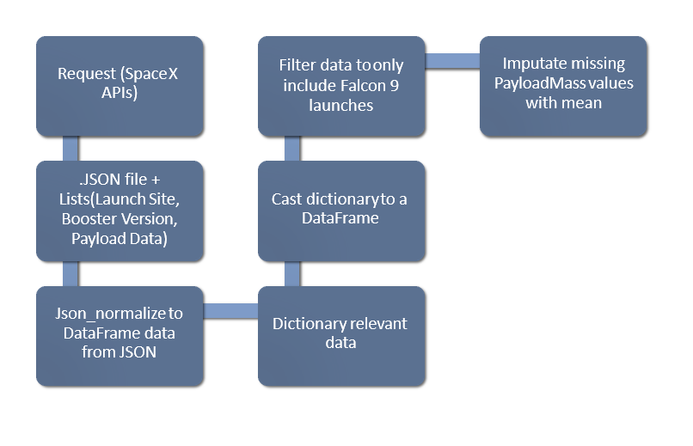
Data Collection – SpaceX API
https://github.com/panyorikome/ibmdatscicoursera/blob/main/AppliedDataScienceCapstone/jupyter-labs-spacex-data-collection-api.ipynb

Slide 9
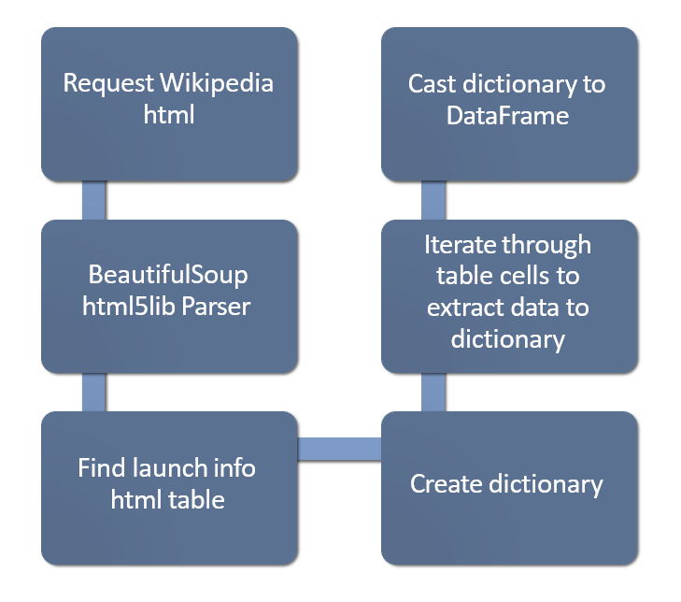
Data Collection - Scraping
https://github.com/panyorikome/ibmdatscicoursera/blob/main/AppliedDataScienceCapstone/jupyter-labs-webscraping.ipynb

Slide 10
Data Wrangling
Create a training label with landing outcomes where successful = 1 & failure = 0.
Outcome column has two components: ‘Mission Outcome’ ‘Landing Location’
New training label column ‘class’ with a value of 1 if ‘Mission Outcome’ is True and 0 otherwise. Value Mapping:
True ASDS, True RTLS, & True Ocean – set to 1 and None None, False ASDS, None ASDS, False Ocean, False RTLS – set to 0
https://github.com/panyorikome/ibmdatscicoursera/blob/main/AppliedDataScienceCapstone/labs-jupyter-spacex-Data%20wrangling.ipynb

Slide 11
EDA with Data Visualization
Plots Used:
Flight Number vs. Payload Mass, Flight Number vs. Launch Site, Payload Mass vs. Launch Site, Orbit vs. Success Rate, Flight Number vs. Orbit, Payload vs Orbit, and Success Yearly Trend
Scatter plots, line charts, and bar plots were used to compare relationships between variables to
decide if a relationship exists so that they could be used in training the machine learning model
https://github.com/panyorikome/ibmdatscicoursera/blob/main/AppliedDataScienceCapstone/IBM-DS0321EN-SkillsNetwork_labs_module_2_jupyter-labs-eda-dataviz.ipynb.jupyterlite.ipynb

Slide 12
EDA with SQL
Using SQL we queried:
Launch site names
Mission outcomes
Payload sizes
Landing outcomes
https://github.com/panyorikome/ibmdatscicoursera/blob/main/AppliedDataScienceCapstone/jupyter-labs-eda-sql-coursera_sqllite.ipynb

Slide 13
Build an Interactive Map with Folium
Folium maps mark Launch Sites, successful and unsuccessful landings, and a proximity example to key locations: Railway, Highway, Coast, and City, this allows us to understand why launch sites may be located where they are. Also visualizes successful landings relative to location.
https://github.com/panyorikome/ibmdatscicoursera/blob/main/AppliedDataScienceCapstone/Interactive%20Visual%20Analytics%20with%20Folium.ipynb

Slide 14
Build a Dashboard with Plotly Dash
The dashboard includes a pie chart and a scatter plot.
The pie chart can be selected to show distribution of successful landings across all launch sites and can be selected to show individual launch site success rates, used to visualize launch site success rate.
The scatter plot takes two inputs: All sites or individual site and payload mass on a slider between 0 and 10000 kg. The scatter plot can help us see how success varies across launch sites, payload mass, and booster version category.
https://github.com/panyorikome/ibmdatscicoursera/blob/main/AppliedDataScienceCapstone/spacex_dash_app.py

Slide 15
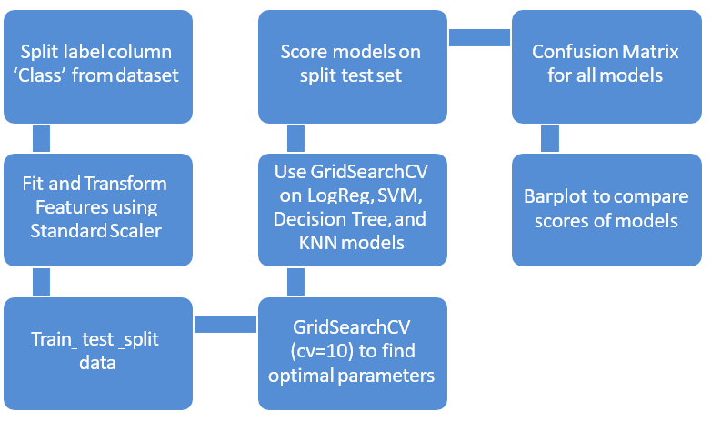
Predictive Analysis (Classification)
https://github.com/panyorikome/ibmdatscicoursera/blob/main/AppliedDataScienceCapstone/IBM-DS0321EN-SkillsNetwork_labs_module_4_SpaceX_Machine_Learning_Prediction_Part_5.jupyterlite%20(1).ipynb

Slide 16
Results
In the result section we will discuss the result of all the analysis done in this project.

Slide 17

Section 2

Slide 18
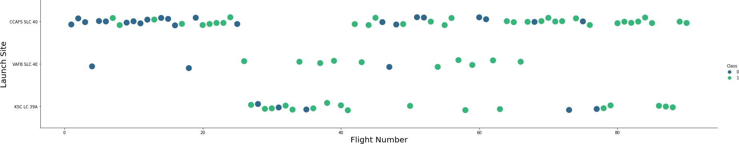
Flight Number vs. Launch Site
Green = successful launch, purple = unsuccessful launch
The success rate in the first 20 flights seem to be the worst. CCAFS SLC 40 is the main launch site by volume.

Slide 19
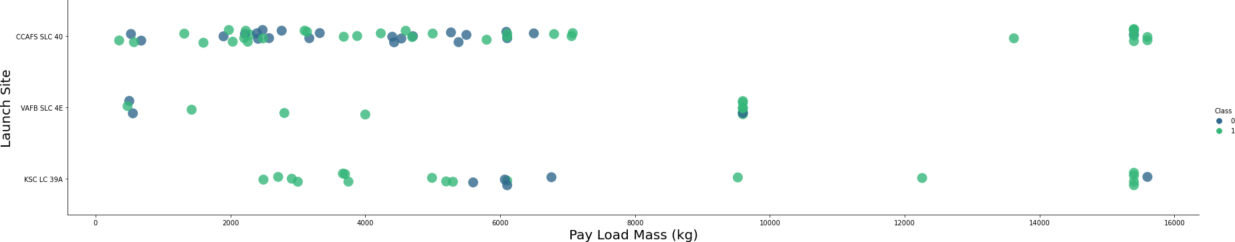
Payload vs. Launch Site
Green = successful launch, purple = unsuccessful launch
Intuitively, you would think that the heavier the payload is the less likely the launch is to be successful. But the graph does not indicate that. Other factors are likely to be omitted in this comparison.

Slide 20
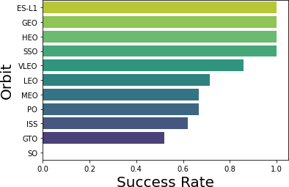
Success Rate vs. Orbit Type
ES-L1, GEO, HEO, and SSO notably have a 100% success rate, but the sample size for each orbit is only 1 except for SSO with 5 launches and 100% success rate. VLEO is quite successful with 14 samples. GTO has the most launches but the least success rate out of all the orbits.

Slide 21
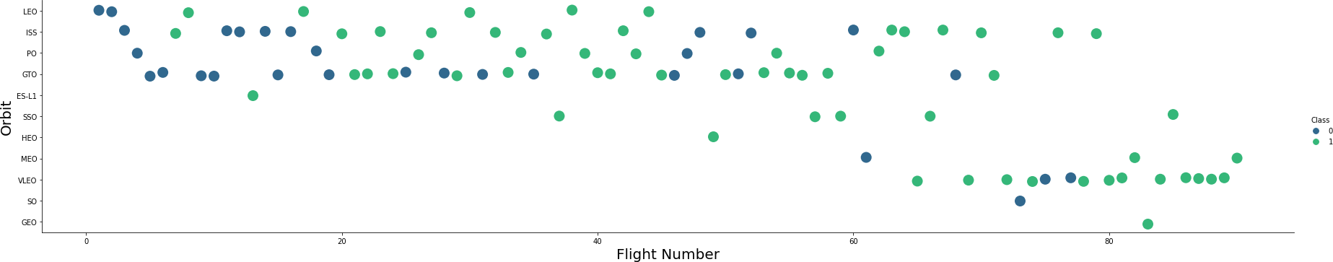
Flight Number vs. Orbit Type
Launch Orbit preferences changed over Flight Number.
Launch Outcome seems to correlate with this preference.
SpaceX started with LEO orbits which saw moderate success LEO and returned to VLEO in recent launches
SpaceX appears to perform better in lower orbits or Sun-synchronous orbits

Slide 22
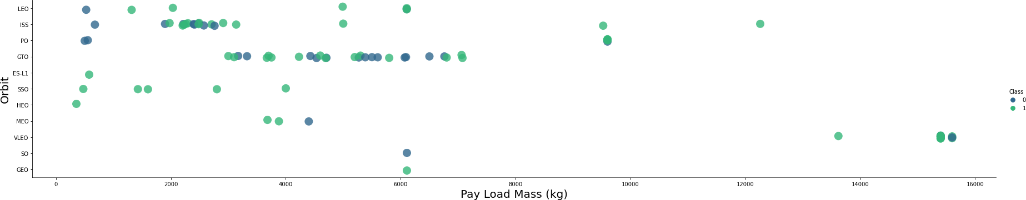
Payload vs. Orbit Type
SpaceX launches rockets with the highest payloads in the VLEO orbit. The other orbits has about the same payload overall with some outliers in ISS and PO

Slide 23
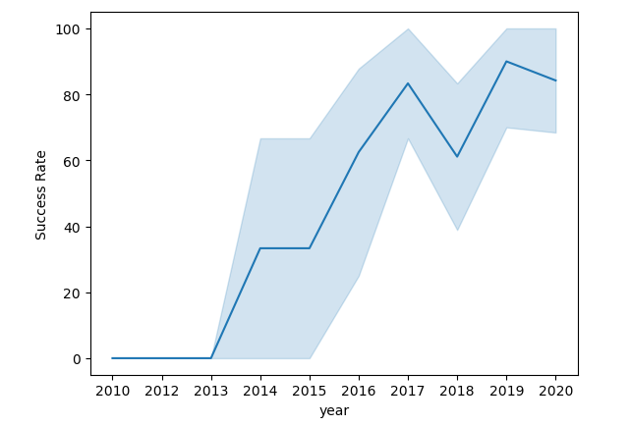
Launch Success Yearly Trend
Launch success rates has been increasing with time.

Slide 24
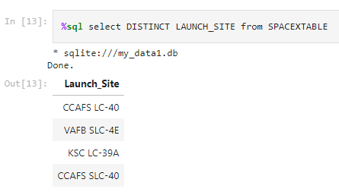
All Launch Site Names
Queried unique launch sites
CCAFS LC-40 and CCAFS SLC-40 are likely to be the same site, data entry error
So only 3 actual launch sites

Slide 25
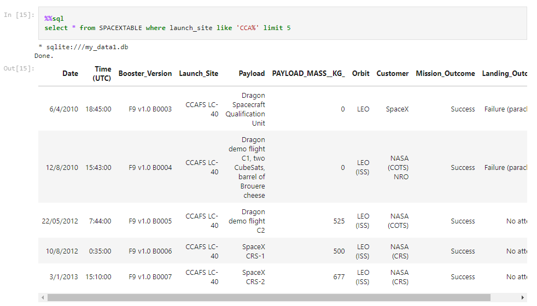
Launch Site Names Begin with 'CCA'
First 5 entries in the database where the launch site name begins with “CCA”

Slide 26
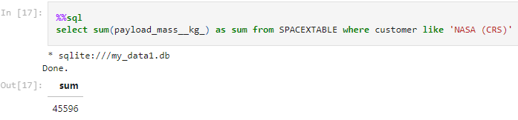
Total Payload Mass
The total payload in KG where NASA is the customer. CRS (Commercial Resupply Services) indicates that these payloads are sent to the International Space Station

Slide 27
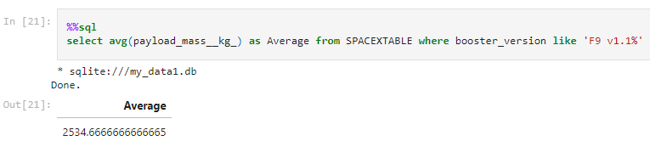
Average Payload Mass by F9 v1.1
The average payload mass in launches which used booster version F9 v1.1

Slide 28
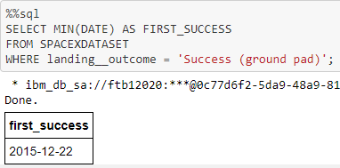
First Successful Ground Landing Date
The first successful ground landing. The date in new data is formatted in dd/mm/yyyy which is not the standard SQL fomat.

Slide 29
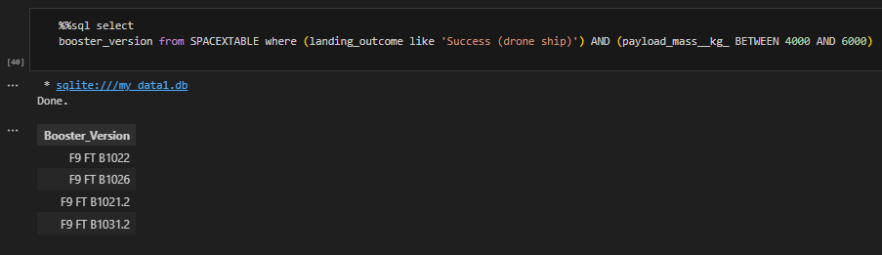
Successful Drone Ship Landing with Payload between 4000 and 6000
This query lists the names of boosters which have successfully landed on drone ship and had payload mass greater than 4000 but less than 6000

Slide 30
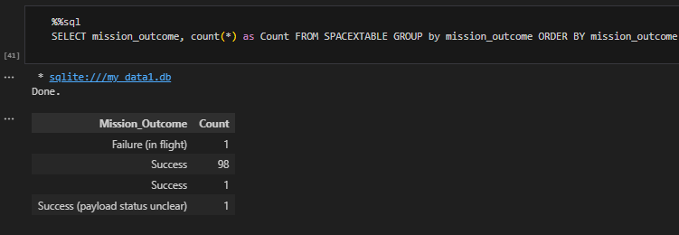
Total Number of Successful and Failure Mission Outcomes
Since the majority of the mission outcome is successful, the landing failures are mostly intentional

Slide 31
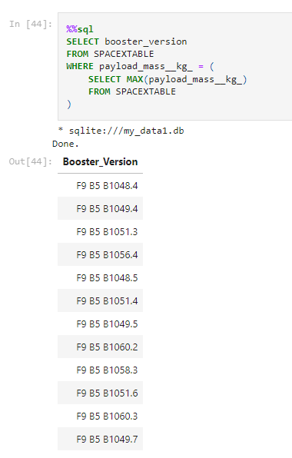
Boosters Carried Maximum Payload
This query lists all booster versions which have carried the maximum payload (15600Kg)

Slide 32
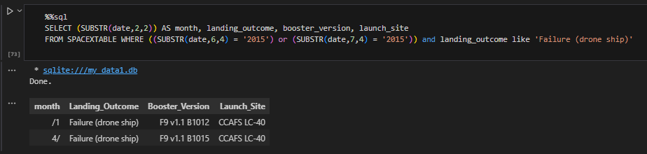
2015 Launch Records
This lists the failed landing outcomes in drone ship, their booster versions, and launch site names for in year 2015
There were 2 occurrences of this in month 1 (January) and 4 (April)

Slide 33
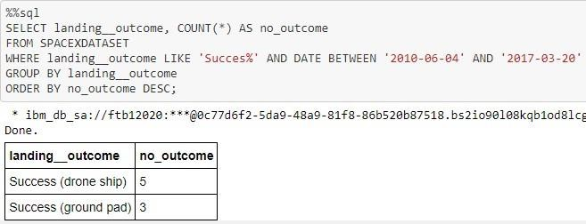
Rank Landing Outcomes Between 2010-06-04 and 2017-03-20
This query ranks the count of landing outcomes (such as Failure (drone ship) or Success (ground pad)) between the date 2010-06-04 and 2017-03-20, in descending order
The 2 kinds of successful landings are “drone ship” landings and “ground pad” landings

Slide 34

Section 3

Slide 35

Launch Site Locations
The left map shows all launch sites relative US map. The right map shows the two Florida launch sites since they are very close to each other. All launch sites are near the coast.

Slide 36

Color Coded Launch Markers
Clusters on Folium map can be clicked on to display each successful landings (green icon) and failed landings (red icon). In this example VAFB SLC-4E shows 4 successful landings and 6 failed landings.

Slide 37



Key Location Proximity
Launch sites are situated near key facilities such as railways for supply transport and the highways for human and other supply transport. All launch facilities are also close to the coast so that the rocket can land in the water for retrieval and minimum damage.

Slide 38

Section 4

Slide 39


Successful Launches by Different Launch Sites
The pie chart shows the distribution of successful landings for each launch site. CCAFS-LC40 and CCAFS SLC-40 is the same place with an updated name. CCAFS has the same amount of successful launches as KSC LC-39A while VAFB SLC-4E has the least.

Slide 40

Launch Sites with the Highest Success Rate
KSC LC-39A has the highest success rate between all launch sites at 76.9%

Slide 41

Payload Mass and Booster Version with Success
1 indicates success while 0 indicates failure. Note that this plotly dashboard does not reach the maximum payload of 15600.

Slide 42

Section 5

Slide 43
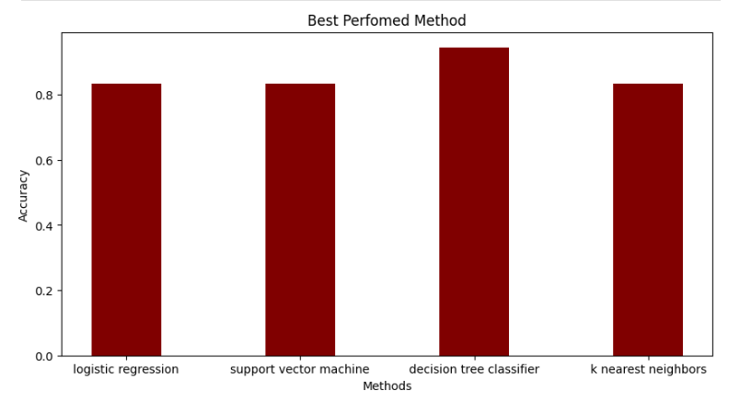
Classification Accuracy
The model with the highest accuracy between our models is the decision tree classifier.

Slide 44
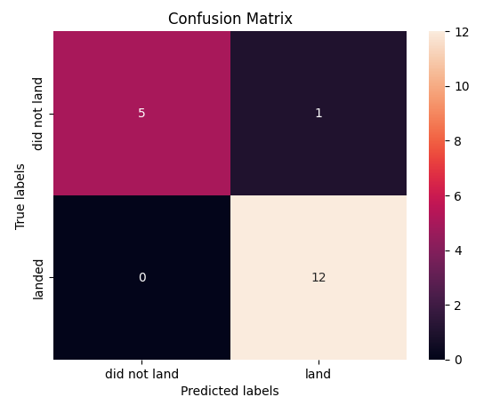
Confusion Matrix
The models predicted 12 successful landings when the true label was successful landing.
The models predicted 5 unsuccessful landings when the true label was unsuccessful landing.
The models predicted 1 successful landings when the true label was unsuccessful landings (false positives).

Slide 45
Conclusions
We developed a machine learning model for SpaceY who wants to compete with SpaceX
The goal is to predict when stage 1 will successfully land to save ~100 million USD
We used data from a public SpaceX API as well as some web scraping
Created data labels and stored it in an SQL database
Created some insightful visualization
Modeled an ML model with an accuracy of 95%
Allon Mask of SpaceY can use this model to predict with relatively high accuracy whether a launch will have a successful Stage 1 landing before launch to determine whether the launch should be made or not
The dataset is still small as not many launches are done, more data will give us better, more accurate models

Slide 46
Appendix
Project GitHub repository:
https://github.com/panyorikome/ibmdatscicoursera/tree/main/AppliedDataScienceCapstone

Slide 47


